Slide 1

vikas
Notes:
mvn archetype:generate -DgroupId = com.vikas -DartifactId =<> -DarchetypeArtifactId = maven-archetype-quickstart -DinteractiveMode = false
mvn install
java –cp target/<>.jar com.<>.App
Download : https://www.oracle.com/in/java/technologies/javase/javase-jdk8-downloads.html#license-lightbox

Slide 2
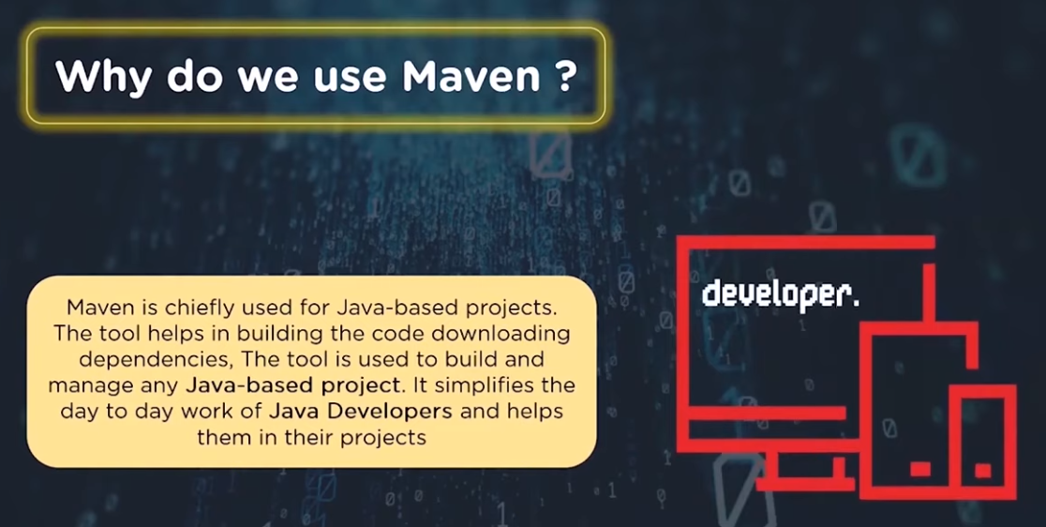
Notes:
Maven helps in getting the right artifact for each project as there may be different versions for different packages .
It will help to download dependencies .No need to go to mvnrepossitory.com .
It’s a open source project build tool .
Maven is Project Object Model (POM) ,helps in simplification and standardization of the project .

Slide 3
Apache Maven is a build automation software for project management and comprehension .
Maven can manage a project’s build, reporting and documentation from a central piece of information of core configuration called POM (Project Object Model) .
What Maven can do?
Manage Builds
Dependencies + versions
Documentation
Project Management
Notes:
Maven is a build automation tool . When you have many third party tools in your project and you have to manage the dependency .So a build automation tool like maven comes to picture .
Maven : Java ,Scala ,c#,ruby
Ant : Java
Gradle : Java
Nant : .net
Pybuilder : python
Model our software project
Centralize project information
Manage our build process
Gather data about our software project and the build itself
Document the software, and our project
Can generate deployable artifacts from source code
Compile, pack, test and distribute your source code
It also create reports, generate a web site for the project and facilitates communication among team members
Dynamically add and update the dependency
Automate build process

Slide 4
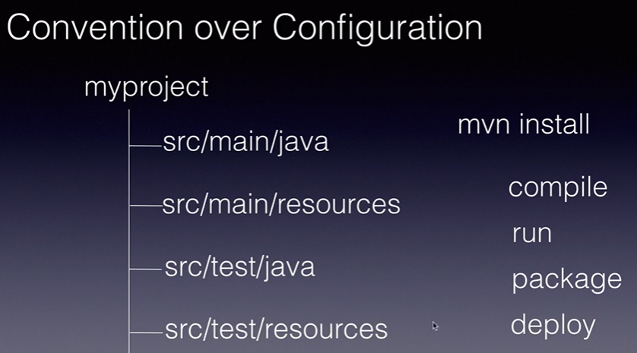
Notes:
Common interface
Dependencies
Repositories
Reuse
https://maven.apache.org/guides/getting-started/maven-in-five-minutes.html
mvn archetype:generate -DgroupId=com.vikas.app -DartifactId=my-app -DarchetypeArtifactId=maven-archetype-quickstart -DarchetypeVersion=1.4 -DinteractiveMode=false
mvn install to start
to run the code
java –cp target/<hellomaven_______________.jar> com.vikas.App

Slide 5
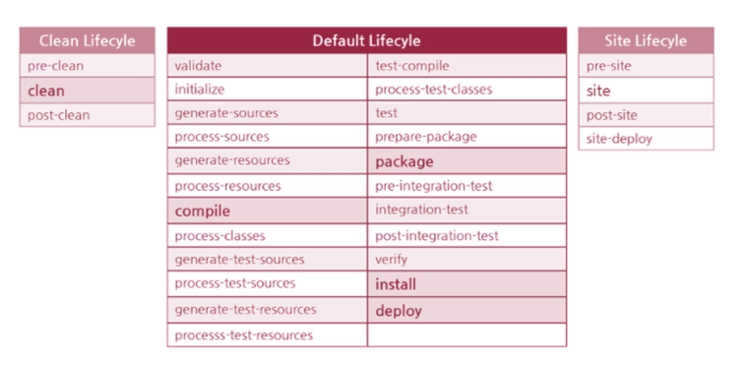
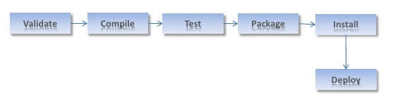
Maven Build lifecycle
Notes:
/var/lib/Jenkins/workspace
Goal -- > task which is executed by plugin
Phases -- > each phase is associated with multiple goals
Validate — checks build prerequisites
Compile — compiles the source code identified for the build
Test — runs unit tests for the compiled code
Package — assembles the compiled code into a binary build result
Install — shares the build with other projects on the same machine
Deploy — publishes the build into a remote repository for other projects to use
Pom.xml has four important co ordinates -- > groupId ,artifact Id ,version ,Packagening .

Slide 6
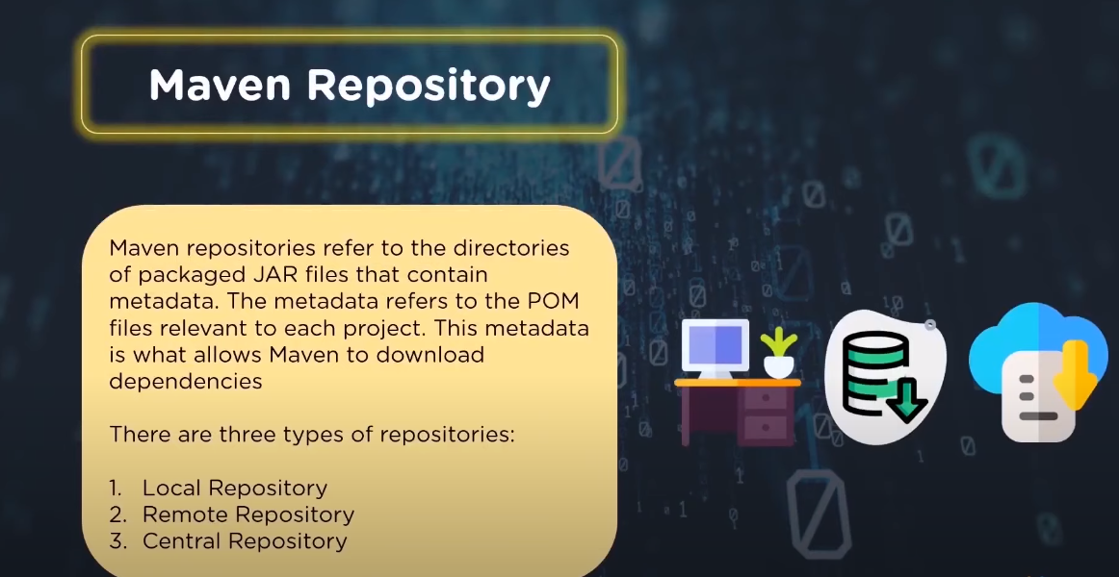
Notes:
Local Repo : Machine of the developer which all the project material and dependency saved .
Remote Repo : Repo on the web server from where maven will download dependency .
Central Repo : Maven community over Internet .

Slide 7
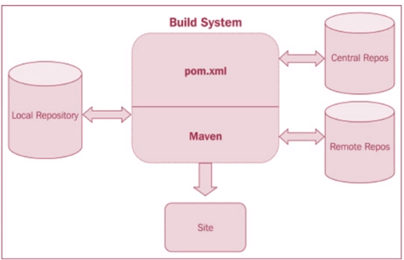
Notes:
Remote Repo : custom dependency files available .searched at last .
https://github.com/vikas99341/game-of-life
Maven Installation :
yum install java-1.8.0-openjdk –y
alternatives --config java (take the path)
yum install maven –y
mvn --version
set JAVA_HOME & MAVEN_HOME PATH from vim /etc/profile -- > towards end add
export JAVA_HOME=<path copied>
export PATH=$JAVA_HOME/bin:$PATH
export MAVEN_HOME =usr/share/maven -- > :wq!
source /etc/profile -- > check echo $JAVA_HOME & echo MAVEN_HOME
Yum install git –y -- > make a dir <> -- > git clone <cloned URL from github.com>
you can directly compile from here -- > mvn compile
you can package the content here -- > mvn package
Interview questions : https://www.youtube.com/watch?v=5iTcAR4fScM

Slide 8
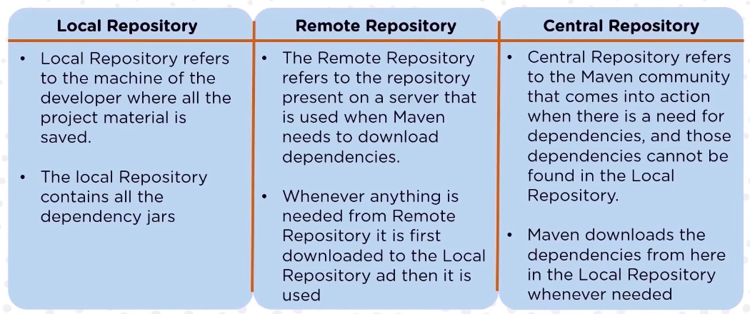
Notes:
Interview Questions :
What is maven artifact ?
What do you mean by maven plugin ?
What is maven snapshot ?
What is maven Archetype ?
Command to create a new project structure ?

Slide 9
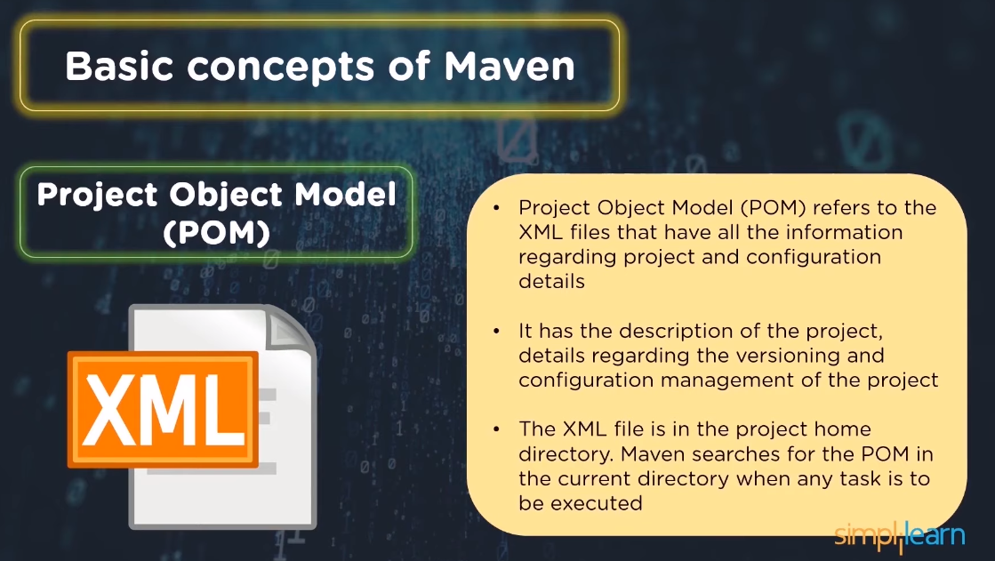

Slide 10
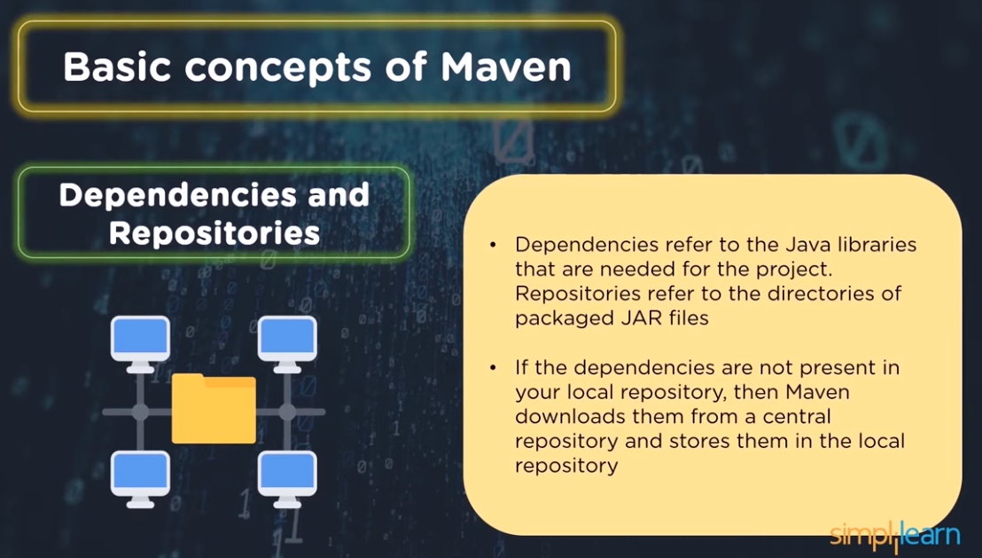

Slide 11
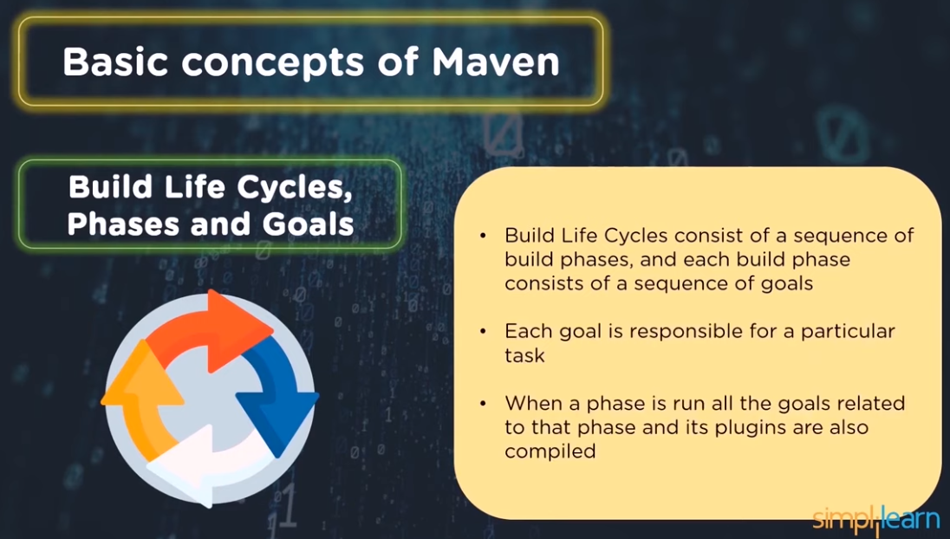

Slide 12
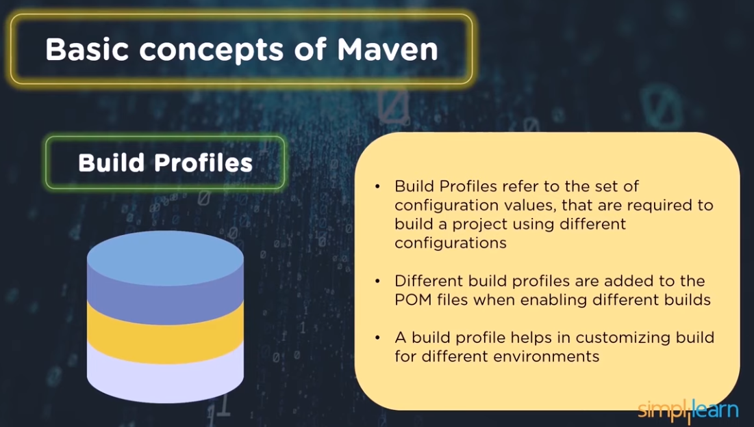

Slide 13
